Slide 1
Leftovers
USC VSoE CSCI 544: Applied Natural Language Processing
Jonathan May -- 梅約納
Nanyun (Violet) Peng -- 彭楠赟
November 28, 2018
Slides from Nathan Schneider, Chris Callison-Burch, Sam Bowman

Slide 2
Reminders
Final project due this Friday (11/30)
Final report uploaded to crowdmark (make sure it contains everything noted and anything additional you were asked to provide)
All code uploaded to vocareum (for documentation; we won't run it.)
final.json uploaded to vocareum. Make sure it matches the required format!!
Review session Friday (11/30): look for piazza inquiry about what topics you want to review
Final Exam next Wednesday (12/5)

Slide 3
Classroom Assignments for Final
Split Class again
NOT the same split
NOT the same alternate room: this time it's THH 201
Please look on Blackboard for your assignment, but basically...
If you were in HAR last time you're in SAL 101 (here) this time
Most of those in SAL 101 are in THH 201 this time
A few "lucky" folks are in SAL 101 both times

Slide 4
What's On The Menu?
How to get data and annotation
Discourse: Recognizing Textual Entailment
Commonsense Knowledge
Poetry Generation (if time)

Slide 5
Human Annotation
Typical approach:
Get some raw data (New York Times archvies for 20 years)
Preprocess it in some manner (e.g. sentence-split, tokenize. Depends on task)
Ask humans to provide information (e.g. POS tags, sentiment, parse tree, ...)
Other variants:
Do some first-pass NLP and ask humans to correct errors
Ask humans to provide data for a label ("write an angry sentence")

Slide 6
Noun, Verb, or Adjective?
We had been walking quite briskly
Walking was the remedy, they decided
Sandburg was a walking thesaurus of folk music
We lived within walking distance of the museum
She used a folded umbrella as a walking stick
Walking briskly is good for your health
The Walking Dead premiered on AMC on October 31, 2010

Slide 7
Annotation is Not That Easy
Pretty much any annotation scheme for language has grey areas where multiple decisions are possible
Human language is flexible! If annotation was easy, language wouldn't be interesting!
Necessary (but not sufficient) remedy: write an annotation standard
Be as clear as you can be to ensure consistency
Annotate yourself, then discuss disagreements and attempt to cover grey areas
Penn treebank POS annotation guideline: 34 pages covering 36 tags
Example: “The temporal expressions yesterday, today and tomorrow should be tagged as nouns (NN) rather than as adverbs (RB). Note that you can (marginally) pluralize them and that they allow a possessive form, both of which true adverbs do not.”

Slide 8
Guidelines Not Sufficient?
No, you'll still have inconsistent (and wrong) annotation. Annotators...
...hit the wrong button
...go too fast, get tired, get distracted
...forget details from the (extensive) annotation guidelines
...encounter cases the guidelines didn't cover
This is science. So let's measure our inconsistency!

Slide 9
Inter-Annotator Agreement
Key Idea: Have multiple annotators annotate the same data and check for disagreements (include yourself as one of the annotators)
Raw Agreement: # of times you agree/# times you annotated the same thing
Problem: assymetric category problem (cf. HW 6 and the "O" label)
 | Annotator A
Annotator B |  | Positive | Negative
 | Positive | 900 | 49
 | Negative | 49 | 2
Agreement = 902/1000 = .902

Slide 10
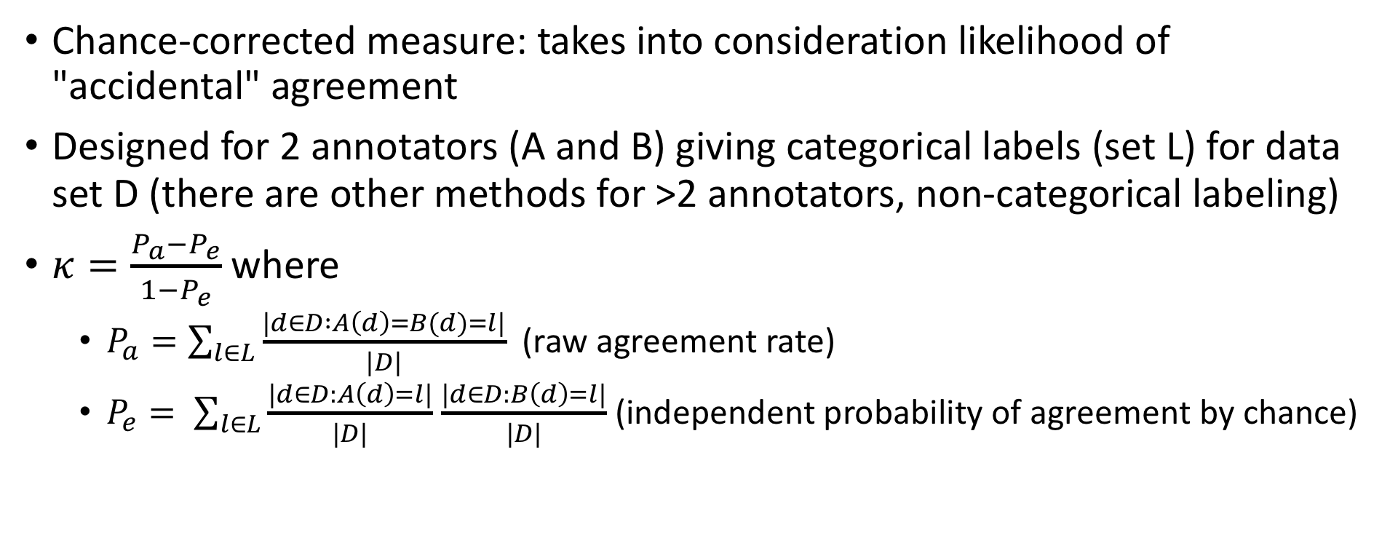
Cohen's Kappa (𝜿)
Chance-corrected measure: takes into consideration likelihood of "accidental" agreement
Designed for 2 annotators (A and B) giving categorical labels (set L) for data set D (there are other methods for >2 annotators, non-categorical labeling)
$κ=\frac{P_{a}−P_{e}}{1−P_{e}}$ where
$P_{a}=\sum_{l∈L}{\frac{|d∈D :A\left(d\right)=B(d)=l|}{|D|}}$ (raw agreement rate)
$P_{e}= \sum_{l∈L}{\frac{|d∈D:A\left(d\right)=l|}{|D|}}$ $\frac{|d∈D:B\left(d\right)=l|}{|D|}$ (independent probability of agreement by chance)

Slide 11
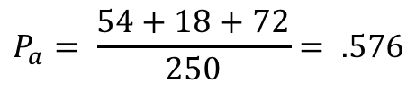
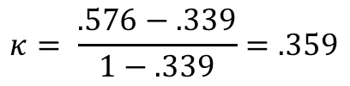
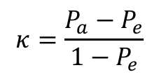
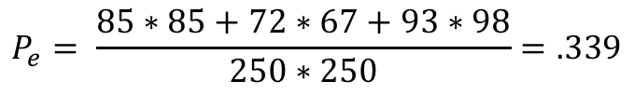
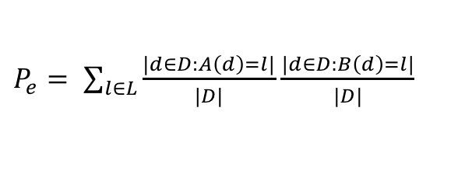
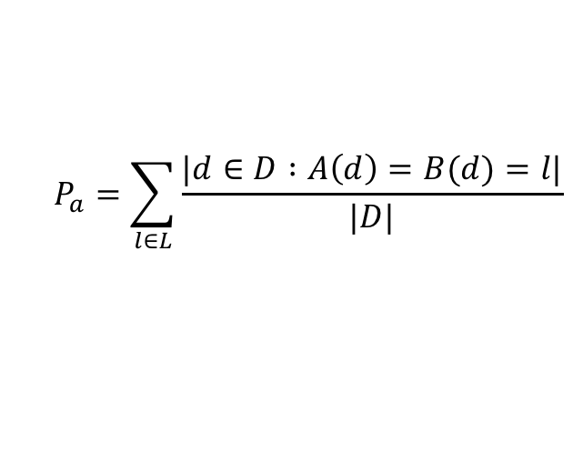
Example: Sentiment analysis
$$κ=\frac{P_{a}−P_{e}}{1−P_{e}}$$
 |  | Annotator B
 |  | positive | neutral | negative
Annotator A | positive | 54 | 28 | 3
 | neutral | 31 | 18 | 23
 | negative | 0 | 21 | 72
Totals (A)
Positive: 85
Neutral: 72
Negative: 93
Totals (B) | Pos: 85 | Neut: 67 | Neg: 98
$$P_{a}=\sum_{l∈L}{\frac{|d∈D :A\left(d\right)=B(d)=l|}{|D|}}$$
$$P_{a}= \frac{54+18+72}{250}= .576$$
$P_{e}= \sum_{l∈L}{\frac{|d∈D:A\left(d\right)=l|}{|D|}}$ $\frac{|d∈D:B\left(d\right)=l|}{|D|}$
$$P_{e}= \frac{85∗85+72∗67+93∗98}{250∗250}=.339$$
$$κ= \frac{.576−.339}{1−.339}=.359$$

Slide 12
 |  | Annotator B
 |  | positive | neutral | negative
Annotator A | positive | 54 | 28 | 3
 | neutral | 31 | 18 | 23
 | negative | 0 | 21 | 72
Raw agreement | 𝜿
.576 | .359
 | Annotator A
Annotator B |  | Positive | Negative
 | Positive | 900 | 49
 | Negative | 49 | 2
Raw agreement | 𝜿
.902 | -.012
 | Annotator A
Annotator B |  | Positive | Negative
 | Positive | 900 | 2
 | Negative | 2 | 96
Raw agreement | 𝜿
.996 | .977

Slide 13
What's a "good" 𝜿?
It depends
Note: independence assumption is used; this isn't always valid
Rare categories do still tend to be underrepresented

Slide 14
Where To Get Your Annotators?
Ask your friends
Problem: You will start to have fewer friends
Hire people and pay them
This is what we used to do. It is cumbersome especially for short term projects
Crowdsourcing
Mechanical Turk
Figure Eight (was crowdflower)

Slide 15
Amazon Mechanical Turk

Slide 16
Original Mechanical Turk

Slide 19
Issues With Crowdsourcing
Teaching a new task remotely is not easy
Can't say "read this 36 page manual and then do everything in it"
Can be surprisingly hard to express what to you is very simple and straightforward
If you can't express your task in one paragraph and bullets, you need to break it into simpler tasks
Pay as an incentive
This is an easy way to get people to help you (other ways: altruism, fun)
Workers are tempted to cheat (use online tools, use bots, answer randomly)
Too low, you won't get high-quality workers (or very many) and you'll get bad reputation
Too high, temptation to exploit increases
What's fair? Minimum wage? Whose country? How to figure out wage rate?

Slide 20
Biggest Issue: Quality Control
There will generally be lower IAA because you have less control over who responds.
Strategies:
Only take workers with high reputation
Finish!

Slide 40
Let's Revisit Semantics (we'll come back to crowdsourcing very soon)
The age of deep learning has led to cool sentence representation
Question: Do these representations know anything about language?
Hypothesis: if we can solve simple problems that really require knowing semantics deeply, then they may as well.
So, let's come up with a task that is such a problem

Slide 41
Recognizing Textual Entailment/Natural Language Inference
Read the following: "The Bermuda Triangle lies in the Atlantic Ocean, off the coast of Florida"
Assume that is true. Would you say then that this is true? "The Bermuda Triangle is near the United States"
t (text) entails h (hypothesis) if a human reading t would infer that h is most likely true.
If a human infers h is most likely false, then t contradicts h ("The Bermuda Triangle is near Japan")
If a human can't tell from t whether h is true or not, then t neither entails nor contradicts h ("Florida has a lot of storms")

Slide 45
Problem
Deep Learning Models are known for needing a lot of training data
Not that much good data for this task!

Slide 58
Densely-Connected Recurrent and Co-Attentive Network Ensemble (Seonhoon Kim et al. '18)
90.1%
Human-level performance: 89.0%

Slide 59
May be overfitting!
SNLI was built in a particular way

Slide 60
Commonsense Information
Can an ocean liner fit through a doorway?
Can Jonathan May (me) run faster than a 1963 Ford Galaxie?
Computer oil vs. poppyseed oil: which is "made-of" vs. which is "used-for"?
If I hold out a whiteboard marker and drop it, what will happen?
You should know the answer to all of these questions even though
The answer is probably not written down (at least not where you saw it)
You may be unfamiliar with some of the specific entities discussed

Slide 61
Humans Learn Common Sense. How?
There's a lot we don't know, but
We're pretty good at (over-)generalizing
We get a lot of signals and feedback while interacting with the world
We've been training for a while! Kids have less common sense (but still more than computers)

Slide 62
Attempts to Build Common Sense By Hand
Cyc knowledge base of general common-sense rules
Started in 1984. (Still going!)
24.5 million facts (mostly hand-edited). Examples:
All trees are plants
Paris is the capital city of France
Overkill? 50-level taxonomy of "microtheories"
Almost no published results
No matter how much is added, facts slip through the cracks
No entry for "mate" (tea from South America)
Lots of synonyms missing

Slide 63
Attempts to Build Common Sense From The Web
NELL (Mitchel et al. 2015)
Look for patterns to draw conclusions
("X is made of Y") -> MADE_OF(X, Y)
"watch is made of metal" ->
MADE_OF(watch, metal)
Discover new patterns from known related items
MADE_OF(watch, metal) ->
"metal that makes your watch" ->
"X that makes your Y" -> MADE_OF(X, Y)
Repeat! (Some filtering of overproductive/nonproductive rules)

Slide 64
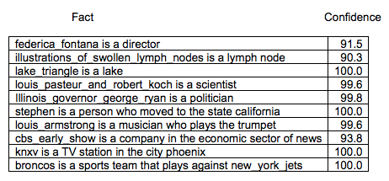



NELL Facts
(model/actor)
Noisy results but pretty impressive on the whole
ceci n'est pa une ganglion lymphematique
But not helpful
company
Not a company

Slide 65
What About a Really Good Language Model?
Language models evaluate output for `naturalness.' This could include common sense, speaking broadly
Q: What is your favorite flavor of ice cream?
A1: My favorite in the dessert are the chocolate ones.
A2: I like long walks on the beach.
A3: Usually I like rocky road but sometimes I'll get peppermint stick.
More importantly, how do we know if a model has learned common sense?
This is important: the big collections haven't been shown to be useful! Can we tease apart "better on translation" etc. from "demonstrates common sense?"

Slide 66
Challenges that Imply Common Sense
Idea: design "tests" as input/output pairs that are easy for humans and should be hard for computers that don't know common sense
Should also not be "solvable" by e.g. simple syntactic analysis
NLI/RTE is one example
How about some others?

Slide 67
Cloze Test
Given a sentence with a word removed, choose the right word
Today, I went to the ________ and bought some milk and eggs.
To aid in evaluation, this is often presented as multiple choice
Good language models can do really well on this!

Slide 68
Story Cloze Test (http://cs.rochester.edu/nlp/rocstories/)
ROC Stories: Univ. of Rochester, 2016
98,000 5-line stories (training) and 3,700 with multiple-choice 5th line:
Karen was assigned a roommate her first year of college. Her roommate asked her to go to a nearby city for a concert. Karen agreed happily. The show was absolutely exhilarating.
Karen became good friends with her roommate.
Karen hated her roommate.
Wide variety of topics

Slide 69
How Was This Assembled?
Mechanical Turk!
Fairly constrained:
Exactly 5 lines
Realistic (no space aliens)
Clear beginning and end
Something happens
Different methodology to get the test set:
Present new turkers with the first four lines
They have to make 1 "right" ending and 1 "wrong" ending
Wrong ending should make sense on its own and involve characters in the story

Slide 70
Use as a Common Sense Task
A shared task (common evaluation at a given time) was held in 2017
Top scorer: Univ of Washington. 72% (human = 100%)
Methodology: Didn't look at the story at all!
Turns out there were systematic biases!
Negative words in the wrong endings
Specific words ("pizza") in the wrong endings
Moral: can be tough to design these cleanly!
Dangerous to let turkers write sentences (motivations are for speed)
Current state of the art (as of 11/22!) is 88%. Unknown methodology...

Slide 71
Other Tasks
Given a partial description, which of several possible endings is most likely?
On stage, a woman takes a seat at the piano. She
sits on a bench as her sister plays with the doll
smiles with someone as the music plays.
is in the crowd, watching the dancers.
nervously sets her fingers on the keys.
Human performance: 88%
Pre-publication, best performance was ~59% using a big language model called ELMO
However, a new big language model (called BERT) got 86.3%

Slide 72

Other Tasks (Coming soon)
2
1
Commonsense inference with vision:
Answer questions based on images
To whom do the bag and items belong to?
They belong to 1 and 2.
They belong to someone who is a patient here.
They only belong to 1.
They belong to the king.

Slide 73
Other Tasks (Coming Soon)
Answer questions requiring understanding of innate physics
Which object can you use instead of a rolling pin?
wine bottle
hair rolls
dough mixer
a large bowl

Slide 74
Solving Common Sense?
Will BERT (or some other LM) solve all of these?
Does BERT contain common sense knowledge?
Will large ontologies help?
Unknown – Current research topic!

